Slide 1
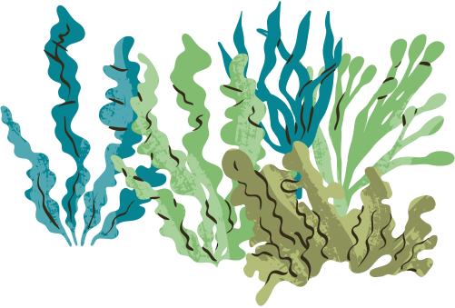
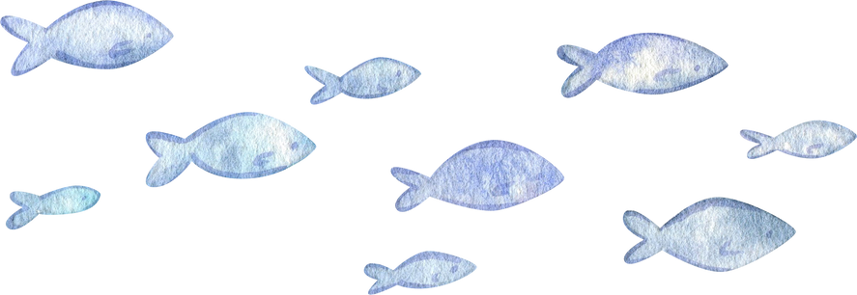
Sustainable management
Catchment areas can be managed sustainably by protecting water sources, reducing pollution, and conserving soil and vegetation.
Strategies include planting trees and vegetation to prevent erosion, controlling urban and agricultural runoff, restoring wetlands, monitoring water quality, and involving local communities in planning and decision-making. These actions help maintain healthy ecosystems, reliable water supplies, and long-term environmental balance.

Slide 2
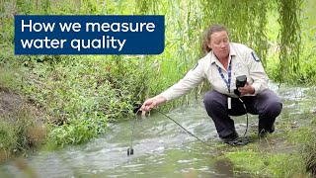
How can we assess catchment health?
Government bodies and organisations regularly implement strategies to manage water; ensuring water systems are functioning effectively and humans are not affecting water quality.
Describe ONE thing the EPA of Victoria do to assess if humans are impacting local waterways.

Slide 3
What is our schools water quality like?
Conduct a catchment walk, where you determine how runoff from our school can impact local waterways.
Working in small groups, visit 4 areas of the school and complete the table to determine how the schools rubbish and pollutants can affect local water.
Notes:
Worksheet 9.1

Slide 4

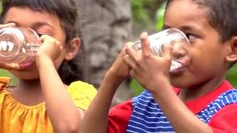
Improving water access
Whilst watching this video from World Vision, answer the following:
How can improved water access improve the wellbeing of people and communities?
How do organisations improve water access?

